Slide 1
AI-Enhanced Gesture Recognition in AR/MR System HIGH FID DESIGN
A Next-Gen Interaction Approach

Slide 2
MODULE 1:System Overview
Visual mockup of a user in AR headset interacting with 3D objects.
Clean diagram: Camera → AI Model → Gesture Recognition → AR Object Response.

Slide 3
MODULE 2:High-Fidelity Design (UI Mockup)
Live camera feed with hand skeleton overlay.
AR object (cube, model, or hologram) glowing when recognized.
HUD overlay with gesture labels & confidence percentage.
Control panel (right side) with toggles/settings.

Slide 4
MODULE 3: Features
Polished icons + text for each key feature:
Real-time gesture tracking
Multi-gesture support
3D object manipulation
AI-powered accuracy
Context-aware interaction
Cross-device compatibility

Slide 5
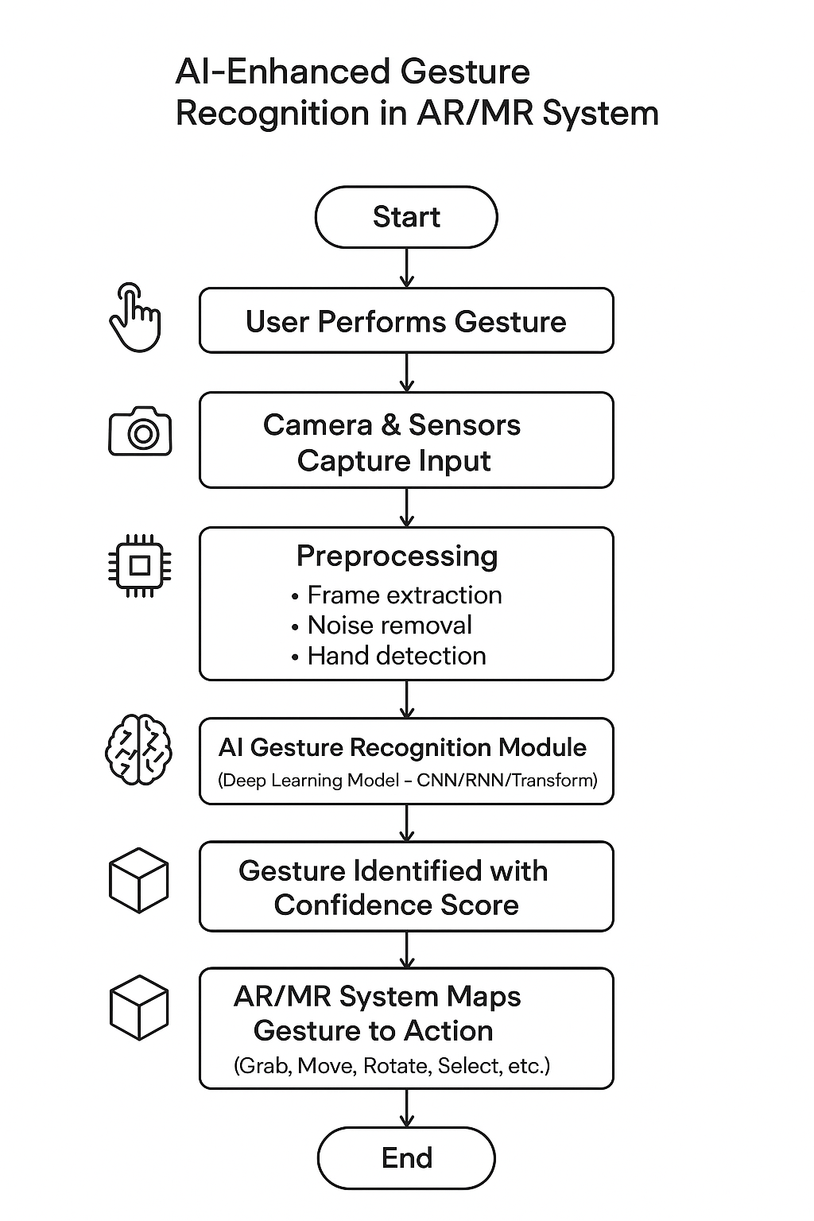
MODULE 4:FLOWDIAGRAM

Slide 6
MODULE 5:Interaction Flow (High-Fid)
Animated-style diagram:
User gesture →
Camera captures hand →
AI recognizes →
AR object responds →
Visual feedback shown

Slide 7
MODULE 6:Use Cases
Gaming (AR/VR interaction)
Education (virtual labs, AR classrooms)
Healthcare (AR-assisted surgery/training)
Industry (remote collaboration, training modules)

Slide 8
MODULE 7:Future Enhancements
Adaptive Gesture Learning
System learns and customizes gestures based on individual users.
Personalized interaction profiles.
Integration with Haptic Feedback Devices
Gloves, wearables, or wristbands for realistic touch sensations.
Enhances immersion in AR/MR environments.
Multi-User Collaboration
Recognize and track gestures from multiple users simultaneously.
Enables shared AR/MR experiences for teamwork, gaming, and training.
Advanced Environmental Adaptation
Robust performance in low-light, outdoor, or cluttered environments.
Dynamic calibration to reduce noise and background interference.
Gesture + Voice Hybrid InteractionCombines speech recognition with gestures for more intuitive control.

Slide 9
MODULE 8:CONCLUSION
The development of AI-Enhanced Gesture Recognition in AR/MR Systems marks a transformative step in redefining human-computer interaction. By eliminating the need for controllers or complex hardware, it enables natural, intuitive, and immersive experiences where the human body itself becomes the interface. This seamless interaction between the physical and digital worlds enhances not only usability but also accessibility, empowering diverse users across industries.The system’s potential applications extend from gaming, education, and healthcare to remote collaboration, industrial training, and smart environments, making it a versatile technology for the future. While current challenges include accuracy under varied conditions, processing latency, and environmental adaptability, continuous advancements in AI models, sensor fusion, and multimodal inputs will ensure greater reliability and scalability.

